Slide 1
QCoDeS tutorial
Delft, July 4th Adriaan Rol

Slide 2
Outline
Introduction
Concepts
Syntax and examples
Discussion

Slide 3
What is QCoDeS?
The goal: to create a common data acquisition framework for all experiments in the Copenhagen/ Delft/ Sydney Station Q consortium… and beyond
- Alex Johnson

Slide 4
Why data acquisition software?
Data acquisition software should perform two tasks
Control instruments
Record data
Additional requirements
Easy to use and learn
Modular and extensible
Automatable
Stable/mature

Slide 5
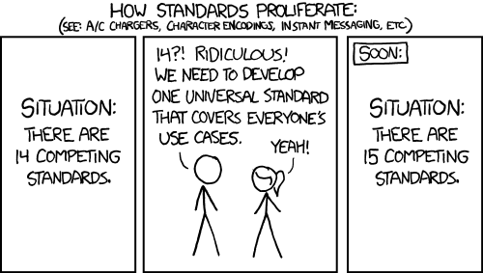
The old situation:
Igor (Alex’s code ~2002)
QTLab (Delft Python package ~2008)
LabVIEW + Mathematica
MATLAB (various ad-hoc efforts)
Some other lightweight Python code
The current situation:
Igor (Alex’s code ~2002)
QTLab (Delft Python package ~2008)
LabVIEW + Mathematica
MATLAB (various ad-hoc efforts)
Some other lightweight Python code
qcodes

Slide 6
What is QCoDeS?
QCodes is:
based on python3 (iPython/Jupyter)
modular by design
based on a minimal set of concepts
Instrument
Parameter
Loop
Dataset
Tested
Collaborative
Requirements
Control instruments
Record data
Easy to use and learn
Modular and extensible
Automatable
Stable/mature
The goal: to create a common data acquisition framework for all experiments in the Copenhagen/ Delft/ Sydney Station Q consortium… and beyond
- Alex Johnson

Slide 7
Concepts

Slide 8

Every experiment consists of a Loop
Loop:
Some parameter(s) is/are varied
Some parameter is measured
Data is saved and analyzed
example of a loop

Slide 9
Parameter
Parameter
an interface to a state/variable of your system
has a get and/or set function
contains meta-data required for datasaving and plotting (name, units)
Any quantity you want to set or measure as part of an experiment loop should be a Parameter.
Can be
part of an instrument
a “manual” parameter that just holds a variable you want logged
a “composite” parameter containing Loops and/or other parameters

Slide 10
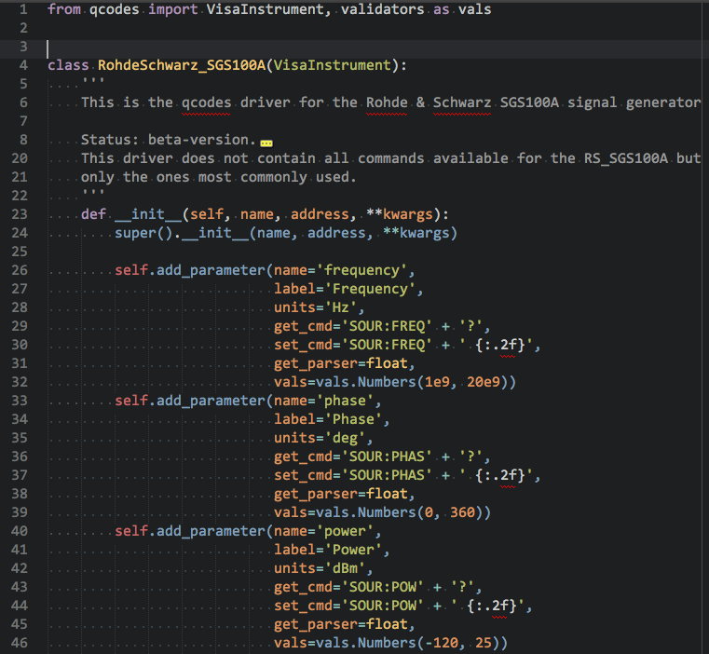
An Instrument is typically a thin wrapper around an instrument driver
A QCodes instrument
Contains parameters
Gets instantiated upon start of the session and remains live during the entire session
Can be anything that contains parameters
A meta-instrument containing other instruments + parameters
A virtual-instrument that only exists in software
Can be instantiated on a server as a remote instrument to with a local proxy (server use is required for Loop)
Example: QCodes: R&S Microwave source driver

Slide 11
Syntax and examples

Slide 12
Open “Qcodes/docs/examples/Tutorial.ipynb”

Slide 13
QCoDeS tutorial
Delft, July 4th Adriaan Rol

Slide 14
What is not in this presentation (but should be)
More details on the instrument server and constraints
Difference between dataset, data formatter and datafile(s)
Probably some more things

Slide 15
Define your system
Main Process
Station
Instrument
Instrument
Parameter
Parameter
Parameter
Parameter
Parameter
Parameter
Parameter
Parameter
Loop

Slide 16
Monitor runs in a separate process
Main Process
Station
Instrument
Instrument
Parameter
Parameter
DataServer Process
Parameter
Parameter
DataServer
Monitor
Parameter
Parameter
Parameter
Parameter
Loop
Disk
Cloud

Slide 17
Start a measurement loop
Measurement
Process
Main Process
Loop
Station
DataSet
Instrument
Instrument
DataArray
Parameter
Parameter
DataServer Process
DataArray
Parameter
Parameter
Formatter
DataServer
IOManager
Monitor
Parameter
Parameter
Parameter
Parameter
Loop
Disk
Cloud

Slide 18
Different DataSet Modes
Measurement
Process
Main Process
Loop
Station
DataSet
Instrument
Instrument
DataArray
Parameter
Parameter
DataServer Process
DataArray
Parameter
Parameter
Formatter
DataServer
IOManager
DataSet
Monitor
Parameter
DataArray
DataSet
Parameter
DataArray
DataArray
Formatter
Parameter
DataArray
Parameter
IOManager
Formatter
Loop
IOManager
Disk
Cloud

Slide 19
Measurement process just talks to DataServer
Measurement
Process
Main Process
Loop
Station
DataSet
Instrument
Instrument
DataArray
Parameter
Parameter
DataServer Process
DataArray
Parameter
Parameter
Formatter
DataServer
IOManager
DataSet
Monitor
Parameter
DataArray
DataSet
Parameter
DataArray
DataArray
Formatter
Parameter
DataArray
Parameter
IOManager
Formatter
Loop
IOManager
Disk
Cloud

Slide 20
Measurement loop finishes
Main Process
Station
Instrument
Instrument
Parameter
Parameter
DataServer Process
Parameter
Parameter
DataServer
Monitor
Parameter
DataSet
Parameter
DataArray
Parameter
DataArray
Parameter
Formatter
Loop
IOManager
Disk
Cloud

